Slide 1
MD vs. Machine
AI in Medical Imaging
Jay Rodge

Slide 2

Hello!
I am Jay Rodge
Former Research Intern, BMW Group
Graduate Student (CS), Illinois Tech
LinkedIn: /in/jayrodge

Slide 3
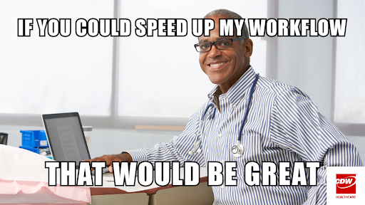

Slide 4
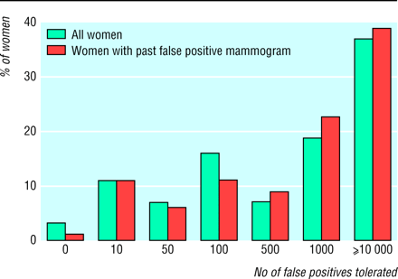
Example: Mammograms
Notes:
Over half off women, who gets a mamogram will receive at least one false positive, that wrong

Slide 5
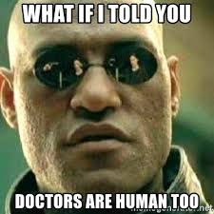
Doctors
How they approach patient problems
Type of health system that supports them
Notes:
This causes wide variations in all clinical outcomes, and this is why machine learning is good option
Natural Biases
Radiologist always disagree on there respective interpretations of medical images
10% accuracy gap

Slide 6
Audio-MNIST
0-9 digits spoken by various people from different country
3000 audio samples for each class
30000 audio files in total

Slide 8
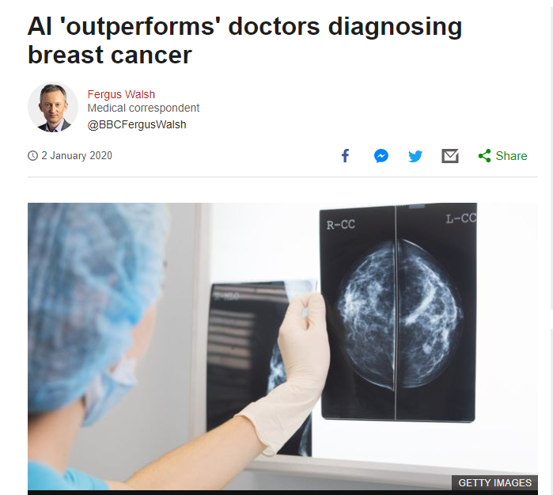
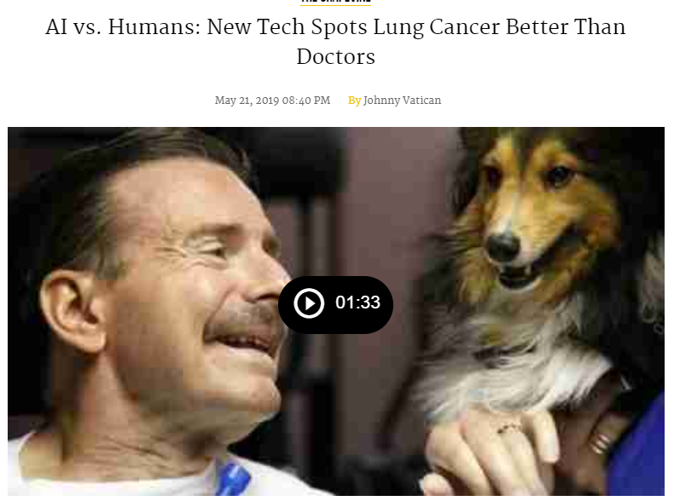
AI

Slide 9
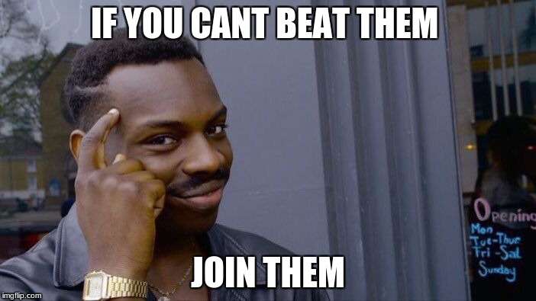

Slide 10
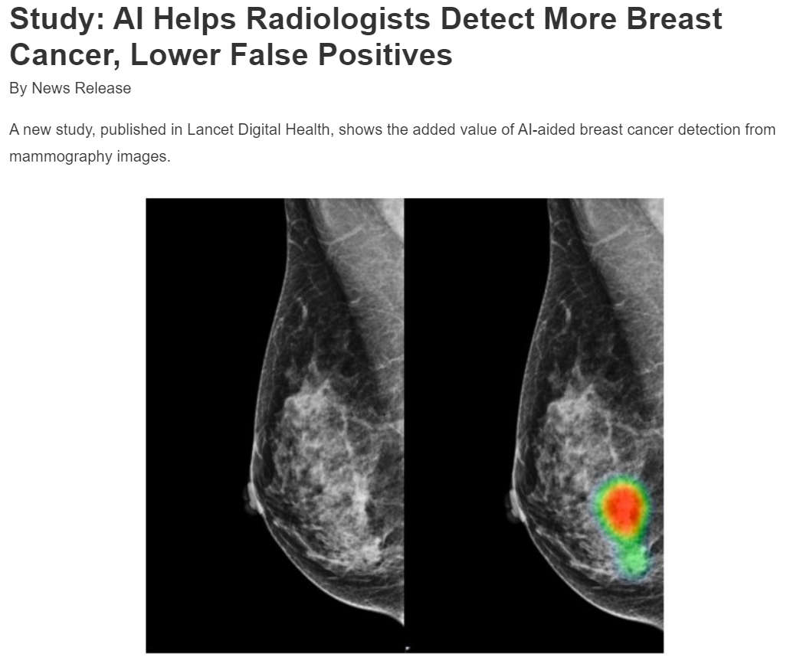
Notes:
he AI alone showed 88.8% sensitivity in breast cancer detection, whereas radiologists alone showed 75.3%. When radiologists were aided by AI, the accuracy increased by 9.5% to 84.8%.

Slide 11
Applications

Slide 12
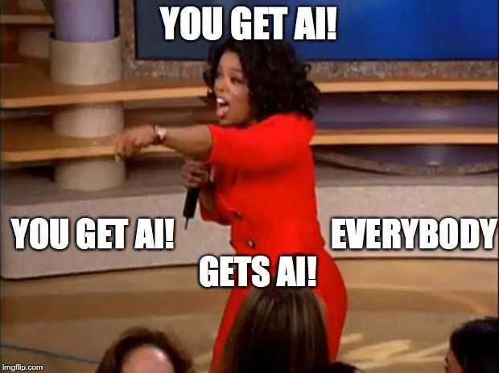

Slide 13
Spinal Cord Gray Matter
Image Segmentation

Slide 14
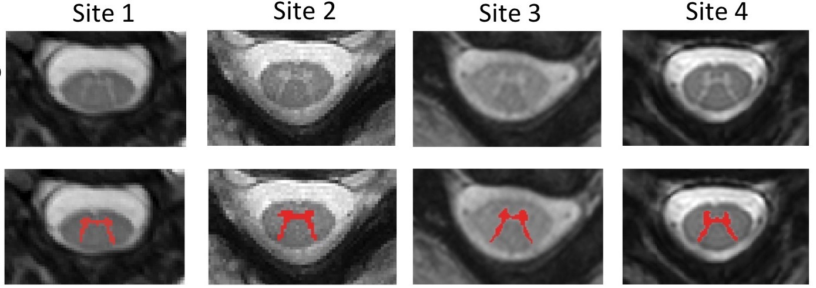
MRI Scans

Slide 15
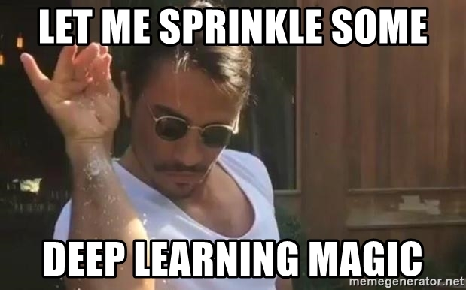

Slide 16
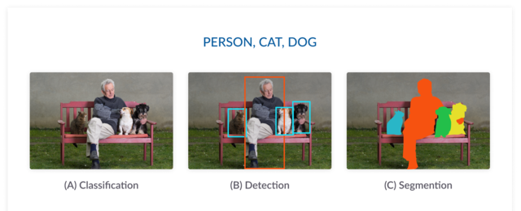
Deep Learning for Vision

Slide 17

UNet

Slide 18
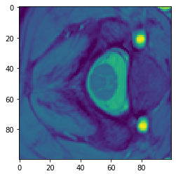
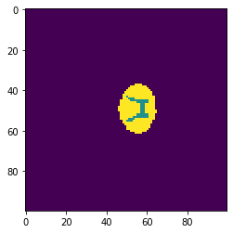
Dataset
GM SPINAL CORD SEGMENTATION CHALLENGE

Slide 19
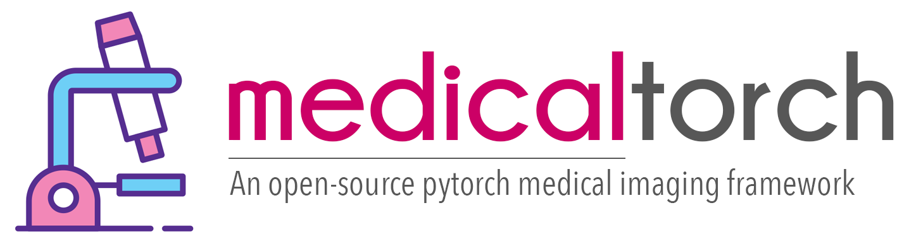
Medical Torch
Framework
Based on PyTorch
Rapid prototyping for Medical Imaging application

Slide 20

Audio-MNIST
0-9 digits spoken by various people

Slide 21
Pipeline
Data
Model
Framwework
UNet

Slide 22

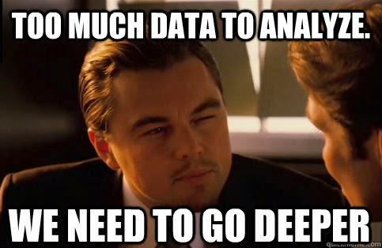

Slide 23
https://colab.research.google.com/drive/1CygP3cnBtZ4deRBS6h4sSW9a1oT2hZUf

Slide 24
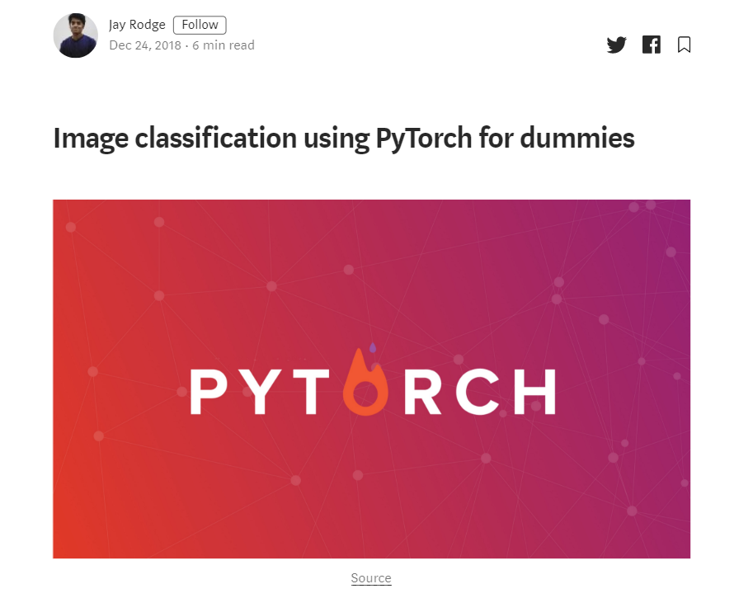

Slide 25



BONUS
hashtagninja.herokuapp.com

Slide 26

Questions

Slide 27


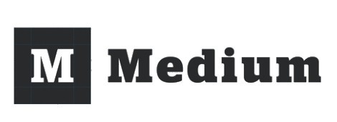
Thank You!
about.me/jayrodge
jayrodge@live.com
/jayrodge
/jayrodge
/@jayrodge

